Slide 1
Theme
Imitation Learning
Deep Reinforcement Learning
Eric Wen
2020.5.9

Slide 2
Main content
⭕ Some interesting things in machine learning
⭕ A brief overview of Deep RL
⭕ A brief overview of Imitation Learning

Slide 3
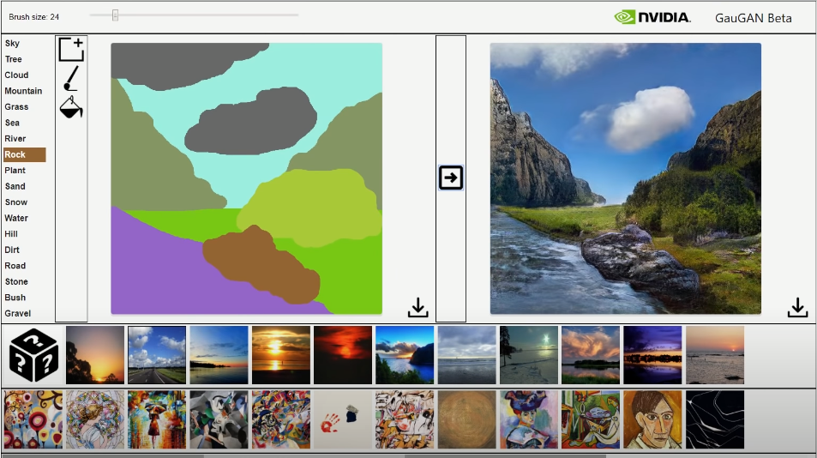
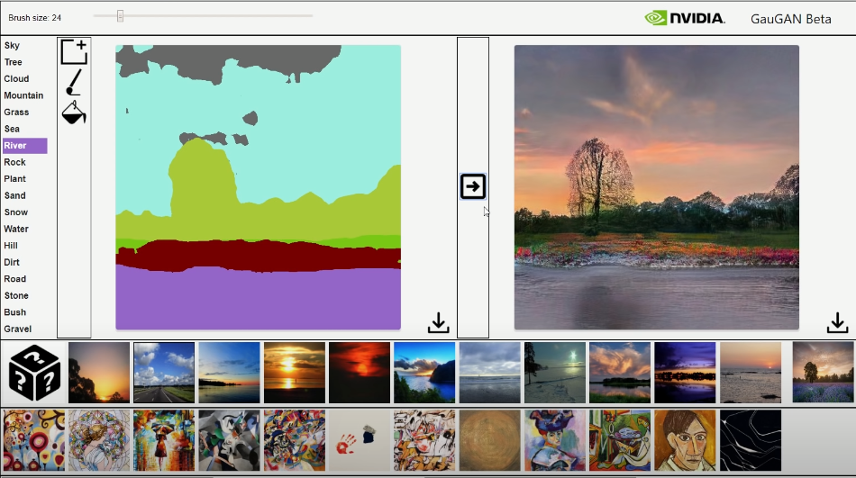
Some interesting things in machine learning
GauGAN
GauGAN
https://www.youtube.com/watch?v=OGGjXG562WU
https://www.youtube.com/watch?v=p5U4NgVGAwg
https://www.youtube.com/watch?v=uNv7XBngmLY

Slide 4
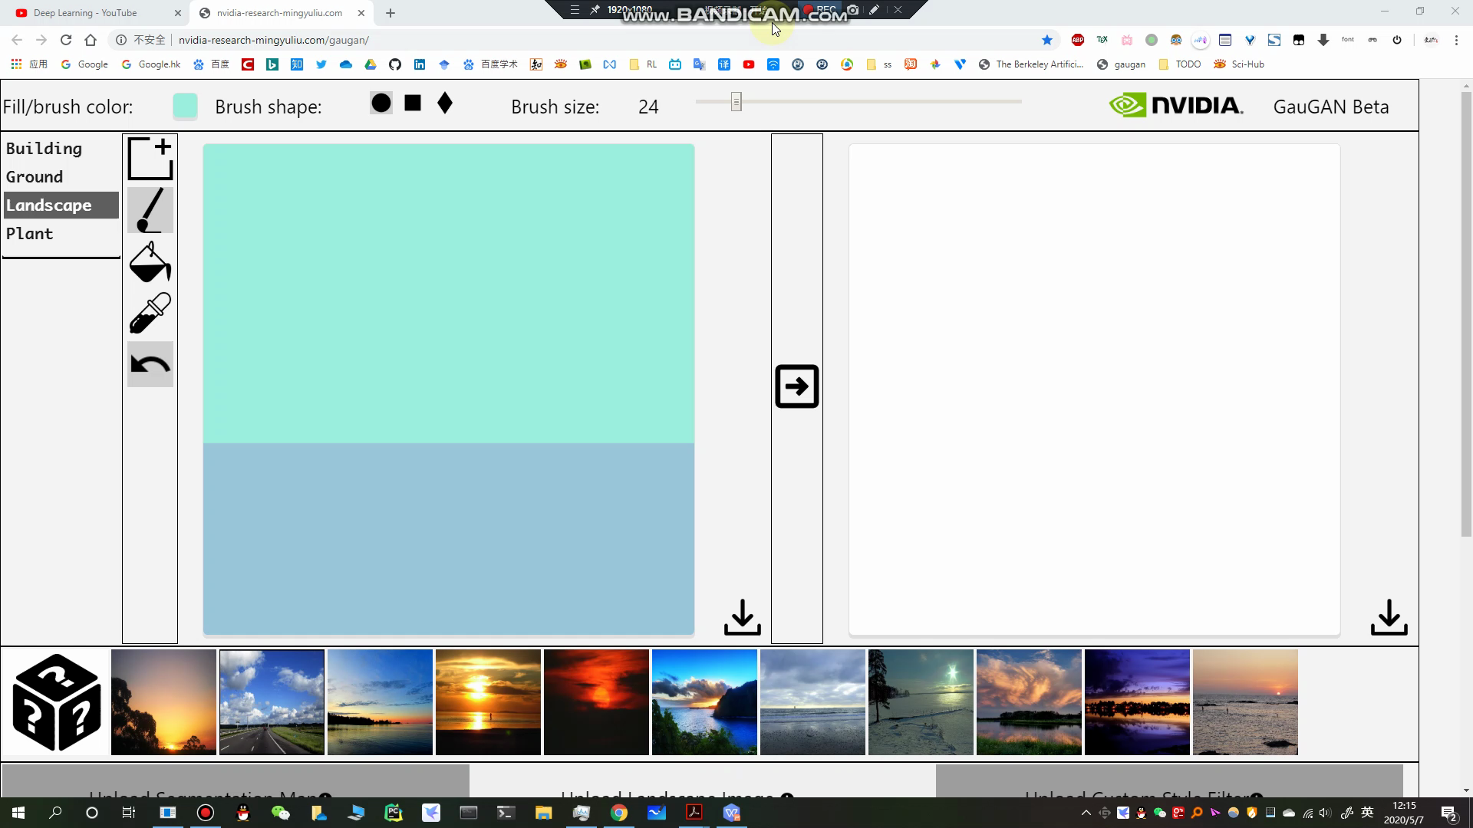
Some interesting things in machine learning
GauGAN

Slide 5
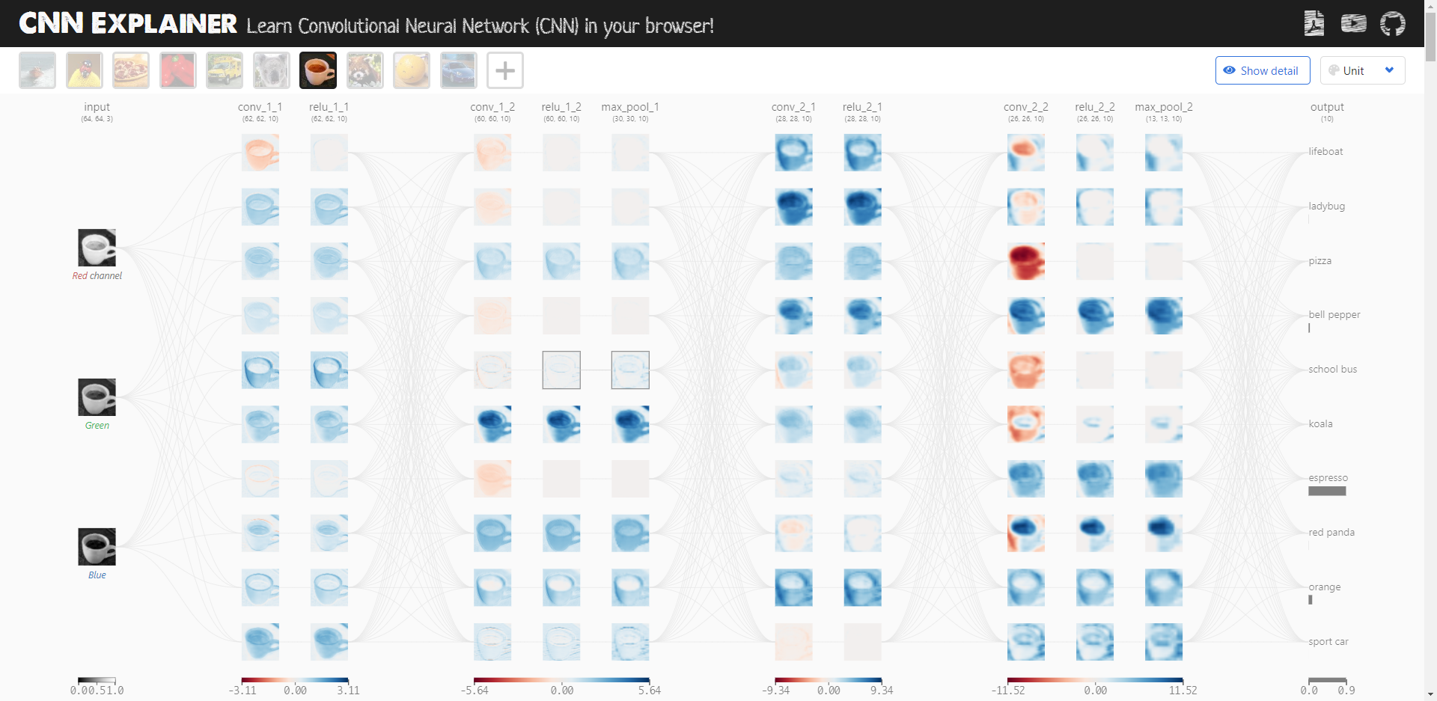
Some interesting things in machine learning
CNN Explainer
Eric Wen
2020.5.9
CNN Explainer
https://www.youtube.com/watch?v=HnWIHWFbuUQ&feature=youtu.be

Slide 6
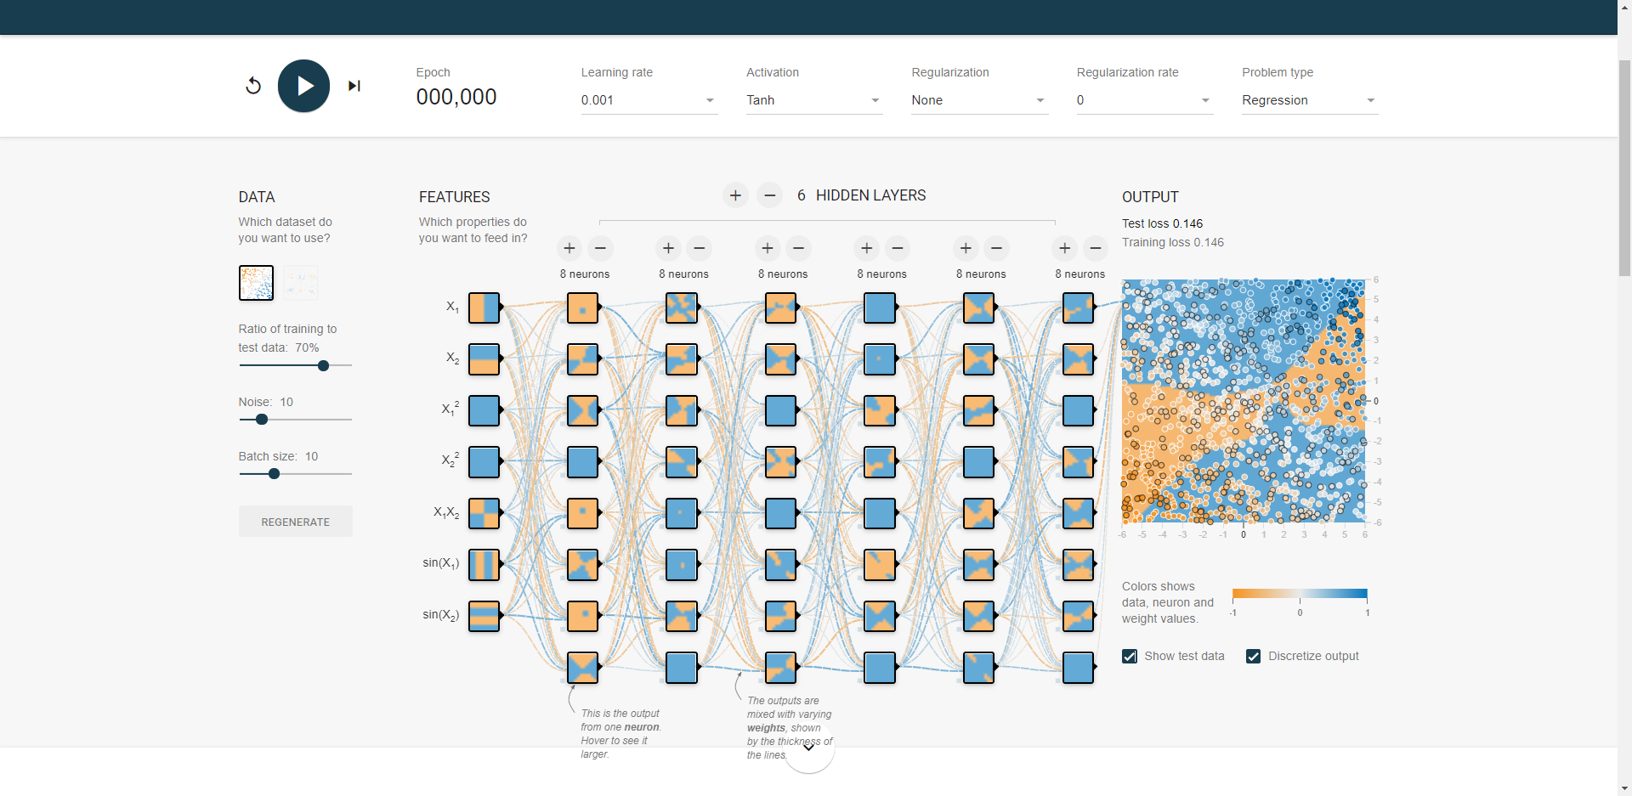
Some interesting things in machine learning
Tensorflow playground
Tensorflow playground

Slide 7
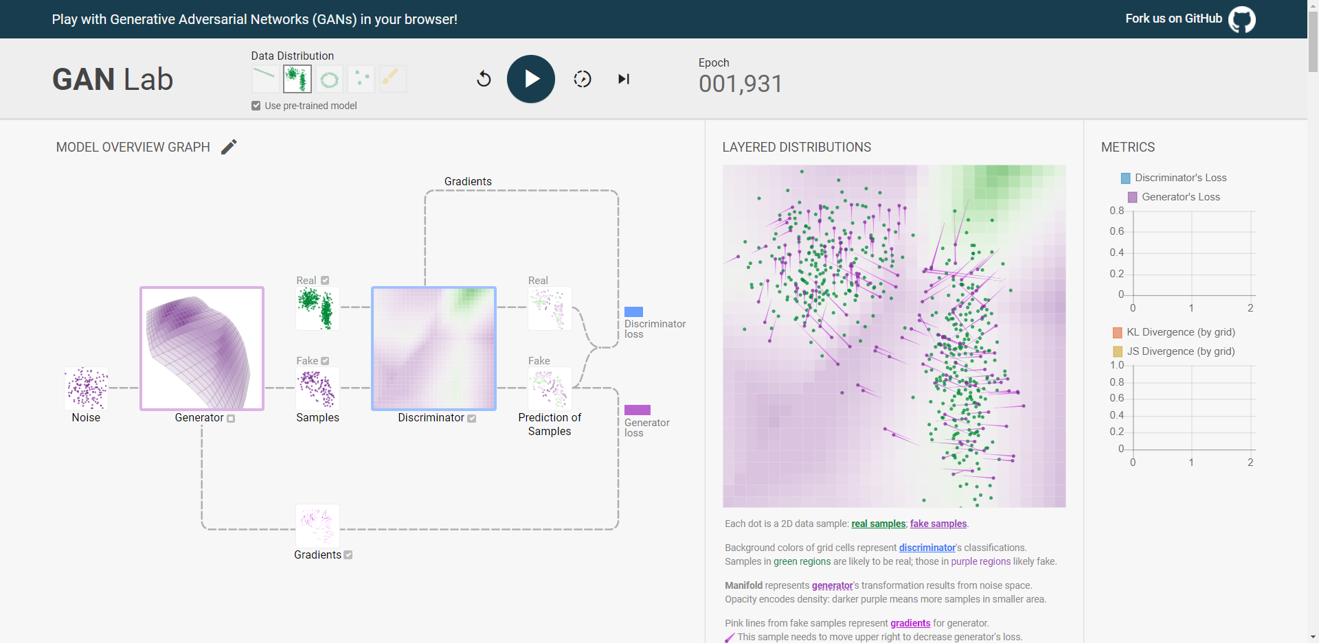
Some interesting things in machine learning
GAN Lab
GAN Lab

Slide 8
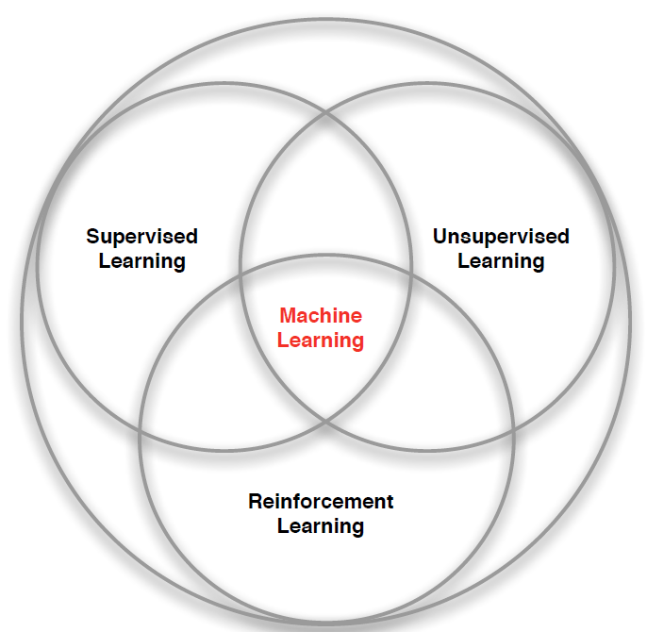
A brief overview of Deep RL
Branchs of Machine Learning

Slide 9
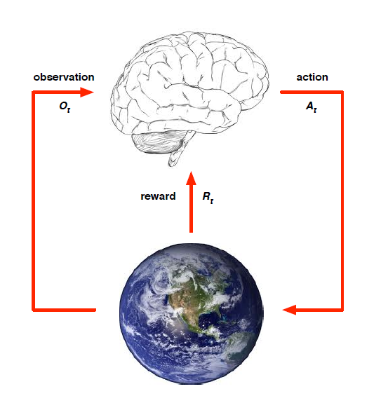
A brief overview of Deep RL
Introduction to RL
⭕ At each step t the agent:
· Executes action A_{t}
· Receives observation O_{t}
· Receives scalar reward R_{t}
⭕ The environment:
· Recerves action A_{t}
· Emits observation O_{t+1}
· Emits scalar reward R_{t+1}
MDP(Markov Decision Processes)

Slide 10
A brief overview of Deep RL
MDP
Markov Property
Definition
A state St is Markov if and only if
⭕ The state captures all relevant information from the history
⭕ Once the state is known, the history may be thrown away
⭕ i.e. The state is a sufficient statistic of the future

Slide 11
A brief overview of Deep RL
MDP
MDP
Definition
A Markov Decision Process is a tuple
⭕ S is a finite set of states
⭕ A is a finite set of actions
⭕ P is a state transition probability matrix,
⭕ R is a reward function,
⭕ is a discount factor

Slide 12
A brief overview of Deep RL
MDP
Value function
Policy
Bellman Equation
Policy Gradient
Bellman Equation
Dynamic programming
Exploration & Exploitation
Monte-Carlo Learning
Temporal-Difference Learning

Slide 13
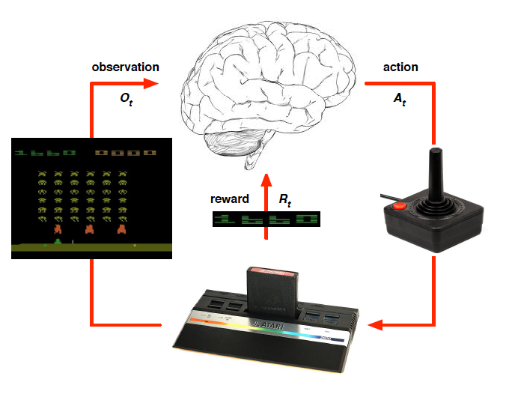
A brief overview of Deep RL
DQN
Q-value 1
state
Network
Q-value 2
Q-value 3

Slide 14
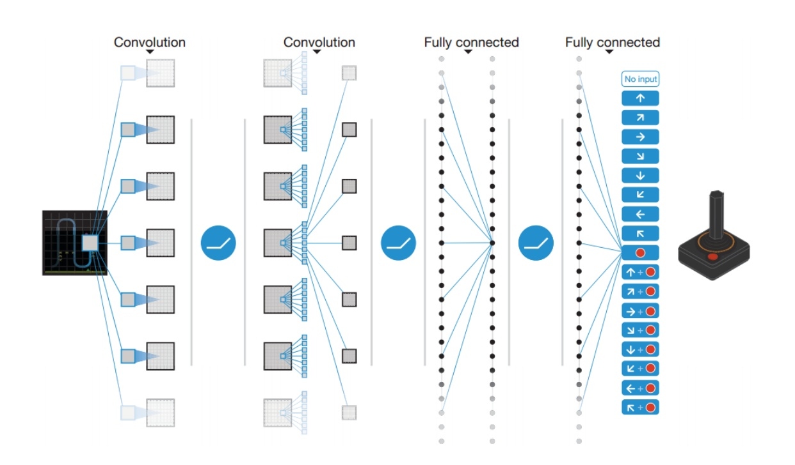
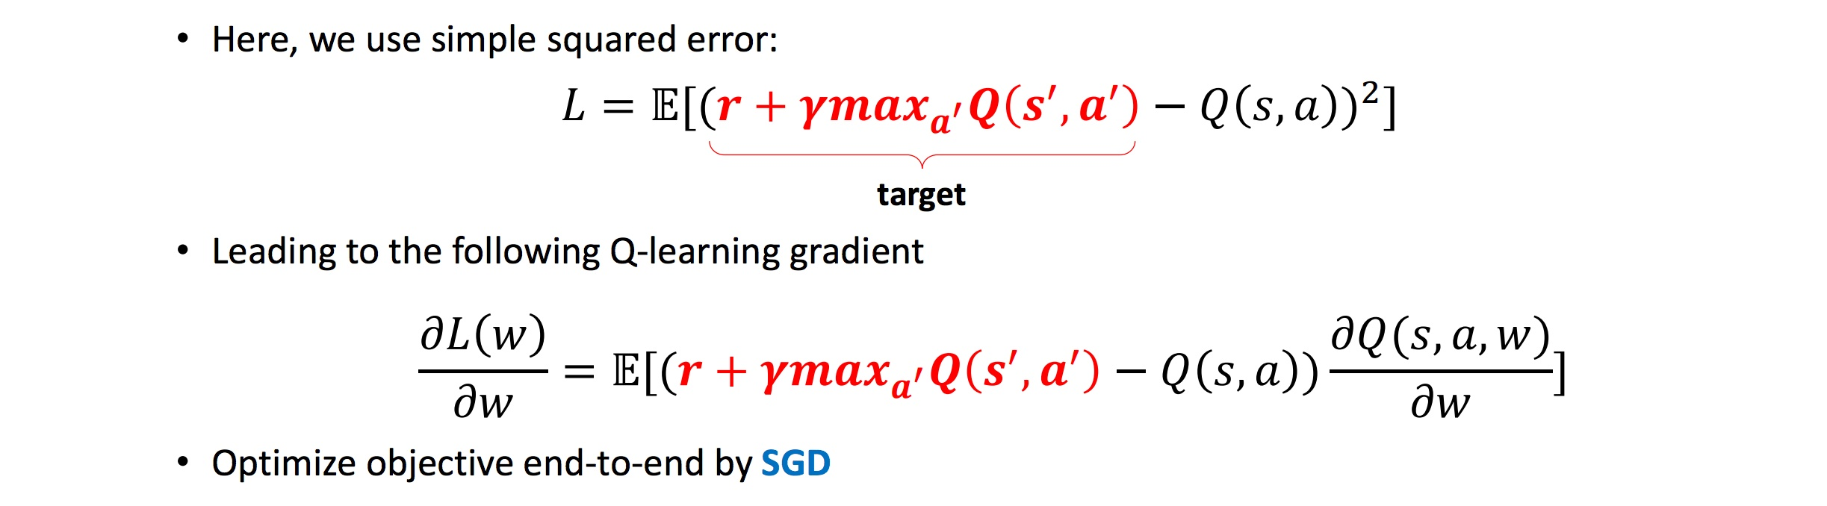
A brief overview of Deep RL
DQN

Slide 15
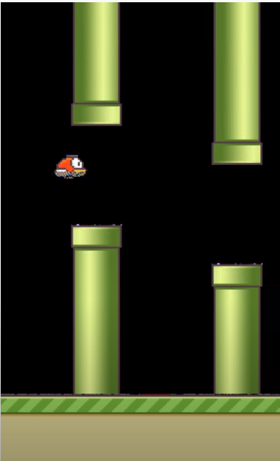
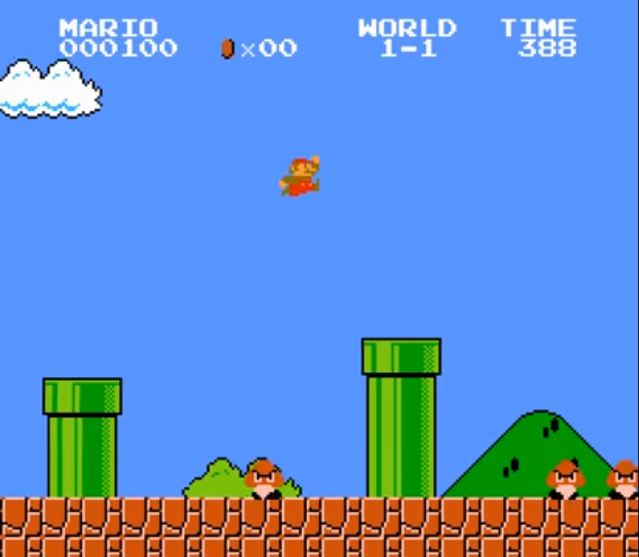
A brief overview of Deep RL
Some applications
Play Super Mario Bros
Github
Flappy Bird
Github

Slide 16
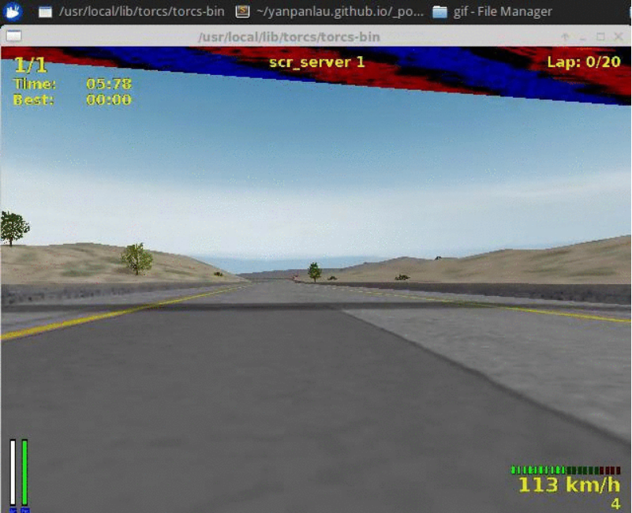
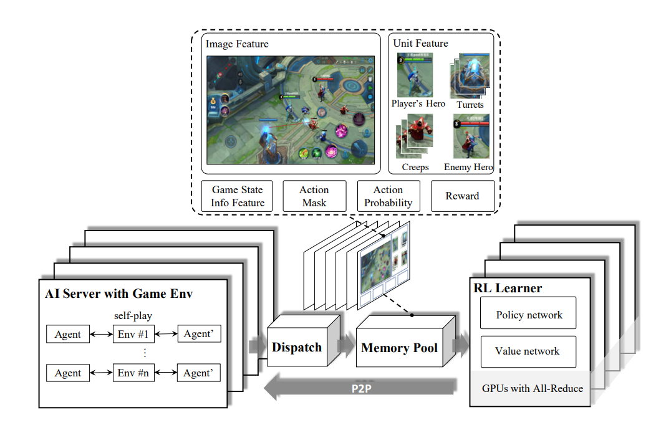
A brief overview of Deep RL
Some applications
MOBA Games
TORCS
Github

Slide 17
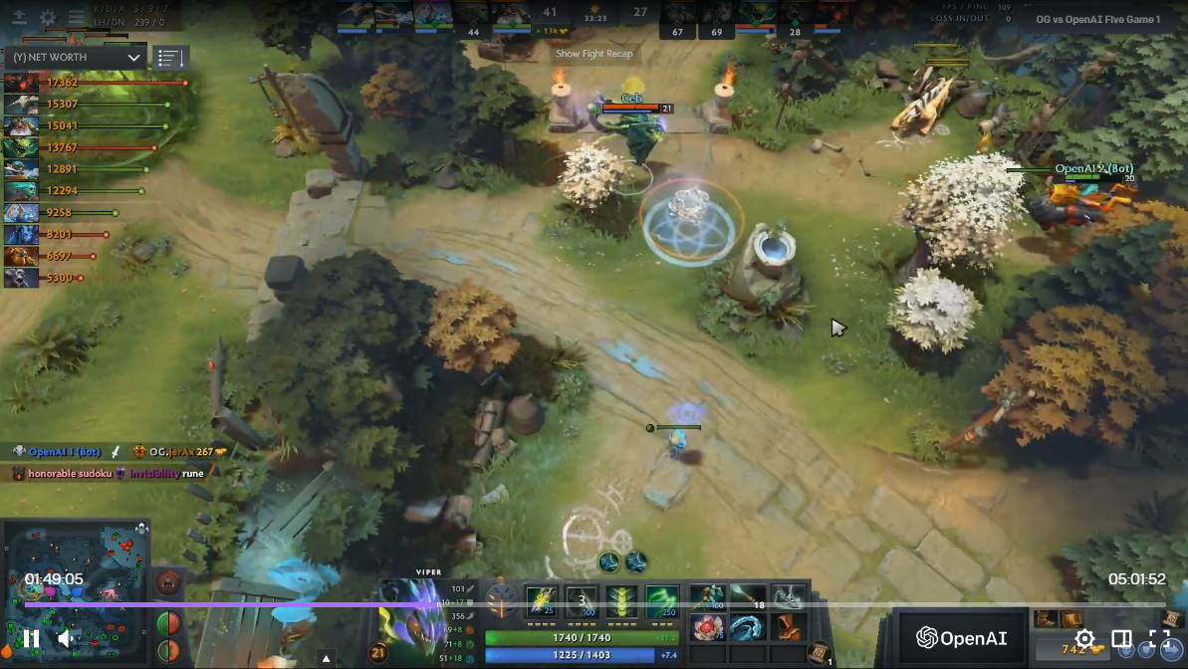
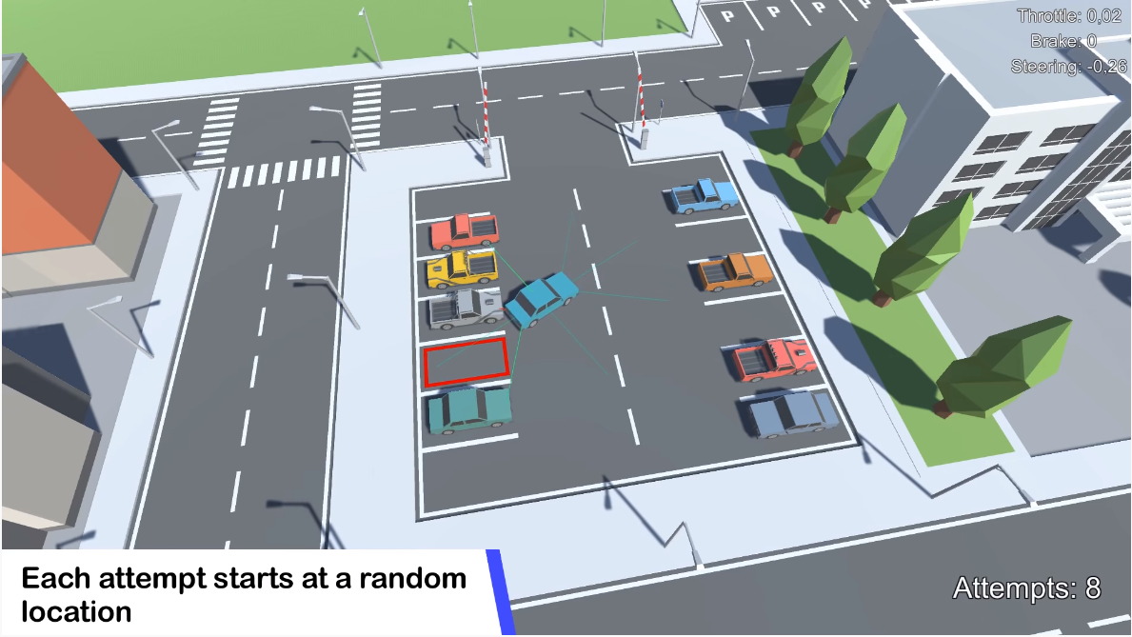
A brief overview of Deep RL
Some applications
Dota2
How to do
packing

Slide 18
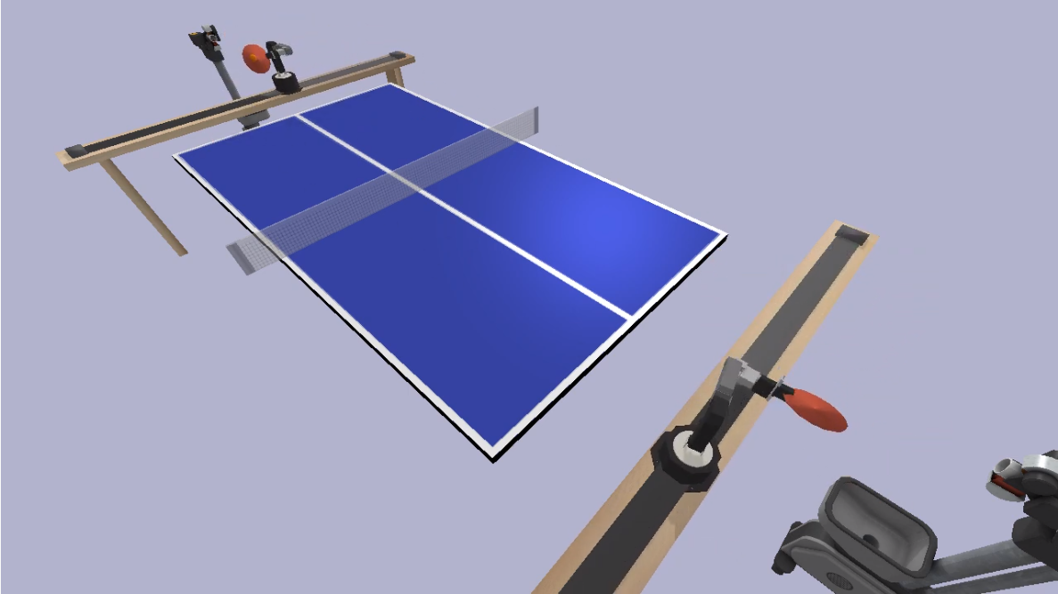
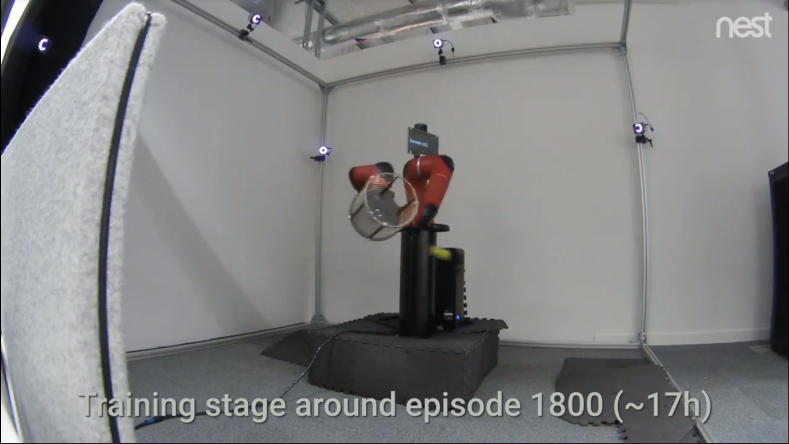
A brief overview of Deep RL
Some applications
Table tennis
How to do
Ball in a cup
How to do

Slide 19
A brief overview of Imitation Learning
Introduction
In IL instead of trying to learn from the sparse rewards or manually specifying a reward function, an expert (typically a human) provides us with a set of demonstrations. The agent then tries to learn the optimal policy by following, imitating the expert's decisions.

Slide 20
A brief overview of Imitation Learning
Branchs
Behavioral Cloning
Direct policy learning
Inverse Reinforcement Learning
learning the expert's policy using supervised learning
IL
learning the expert's policy using supervised learning, and quering the expert to evaluate the roll-out trajectory
learning the reward function of the environment based on the expert’s demonstrations, and then find the optimal policy using reinforcement learning

Slide 21
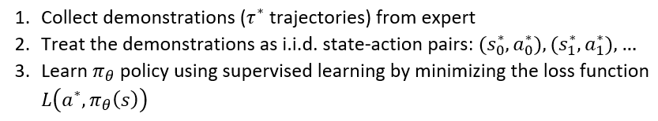
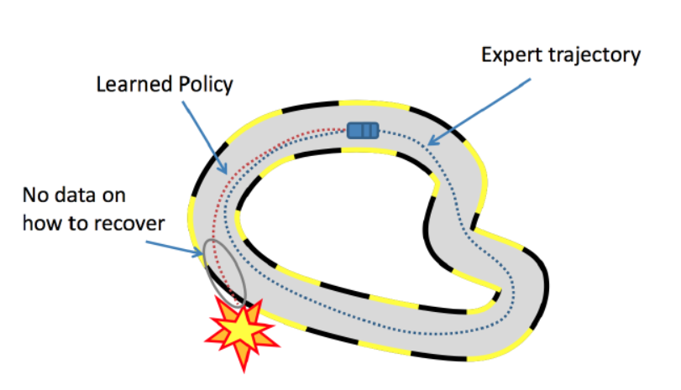
A brief overview of Imitation Learning
Branchs
Behavioral Cloning
Direct policy learning
Inverse Reinforcement Learning
IL

Slide 22
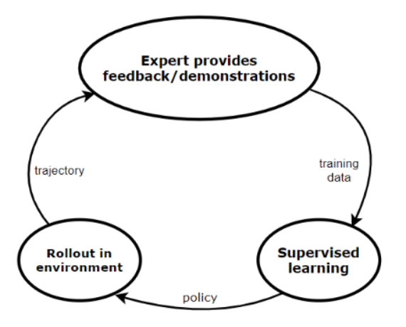
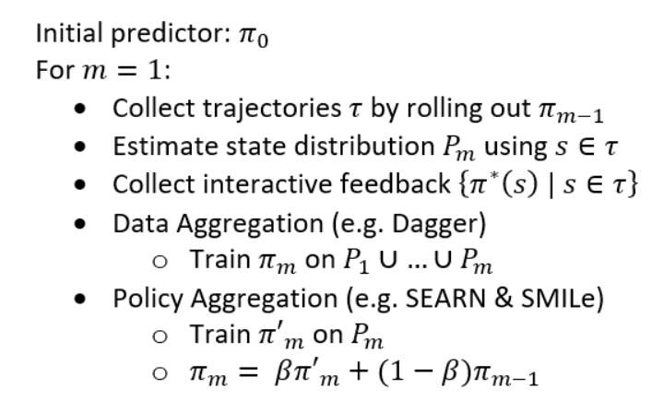
A brief overview of Imitation Learning
Branchs
Behavioral Cloning
Direct policy learning
Inverse Reinforcement Learning
IL

Slide 23
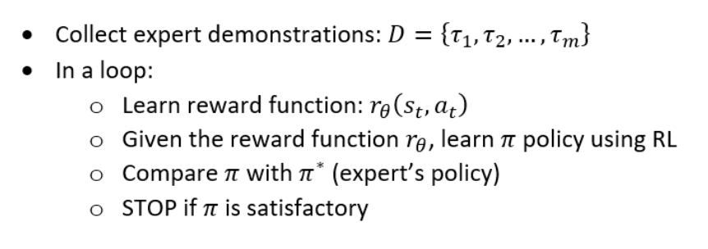
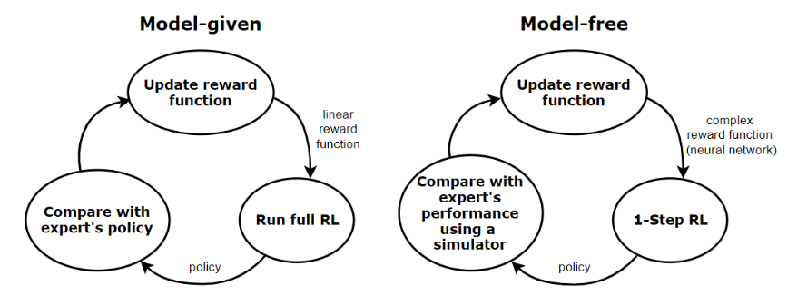
A brief overview of Imitation Learning
Branchs
Behavioral Cloning
Direct policy learning
Inverse Reinforcement Learning
IL

Slide 24
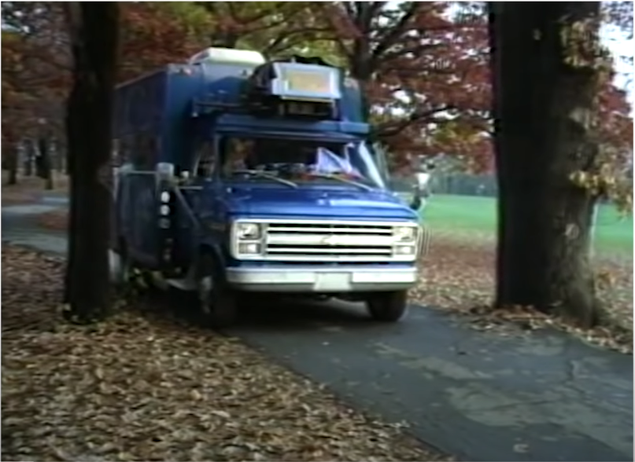
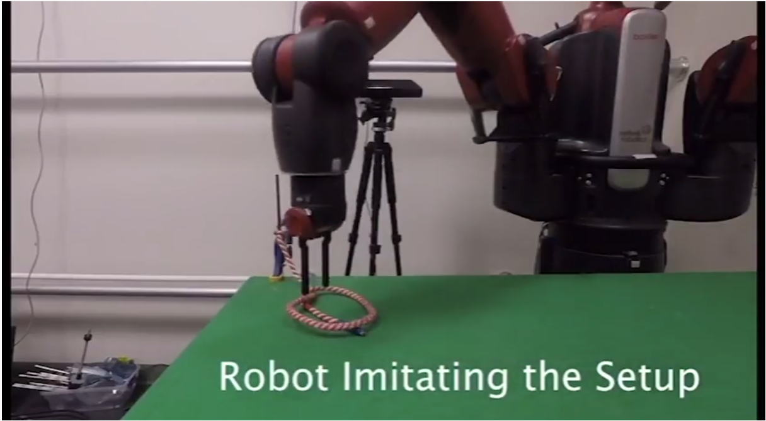
A brief overview of Imitation Learning
Applications
zero shot imitation
1989 ALVINN

Slide 25
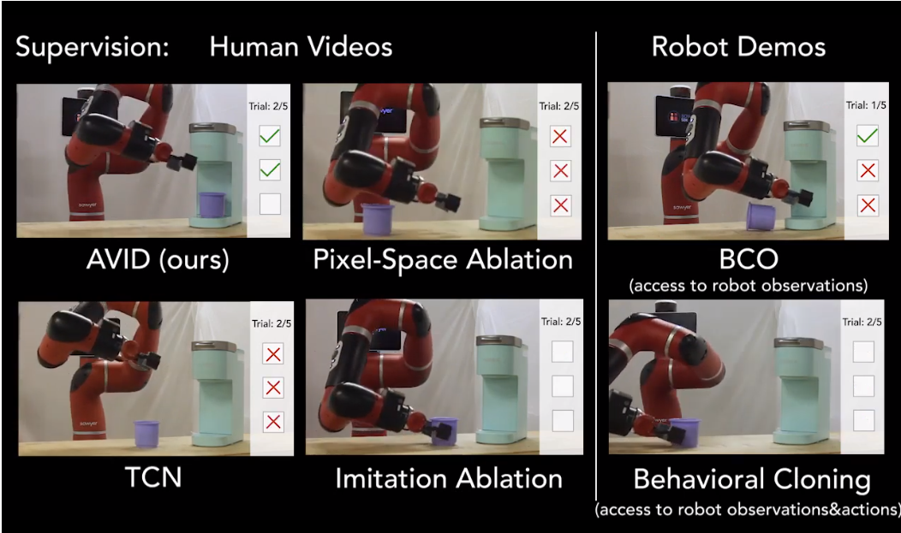
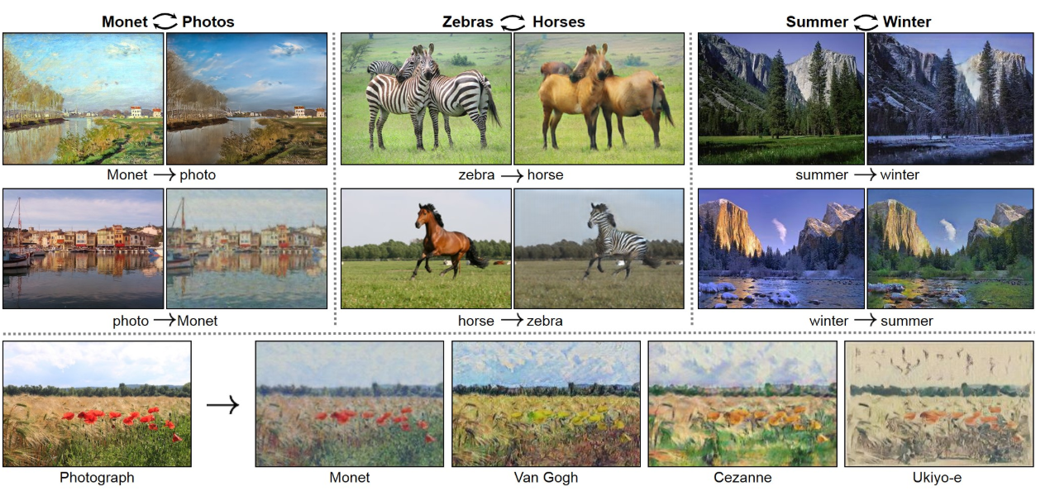
A brief overview of Imitation Learning
Applications
Imitation via CycleGAN
CycleGAN

Slide 26
END
THAT'S ALL
THANK YOU
Eric Wen
2020.5.9

